Slide 1
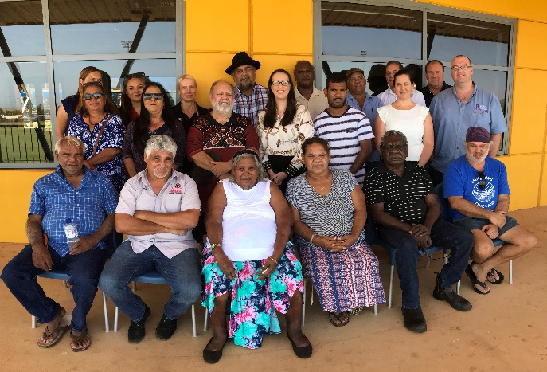
Summary of Formal RIC Meeting – 20 and 21 February 2019 (Karratha) A Pilbara- based regional committee of representatives from Banjima, Karlka Nyiyaparli, Kuruma Marthudunera, Ngarlawangga, Ngarluma, Puutu Kunti Kurrama, Pinikura, Yinhawangka and Yindjibarndi people and Rio Tinto RIC vision: We, like all people, think forward 100 years and ask what we hope for our children’s children and their grandchildren. We want to put in place now, things for the future. We want a future to be one in which they are recognised, respected, equal and strong. We want this for them so they carry on our tradition through Land and Custom.
THIS MEETING’S KEY DISCUSSION POINTS
RIC Report | RIC Education Working Group
The RIC Report working group representatives are meeting with State Government to present the RIC Report findings and options for collaboration to address key issues and explore opportunities highlighted in the Report. A ‘calendar of events’ is being developed to highlight opportunities for the RIC working group to present the RIC Report findings to key stakeholders and attend conferences on behalf of the RIC. The RIC Report and supporting infographic will be added to the RIC Website when it goes live at the end of March. | Following the release of the RIC Report key findings, the RIC decided at the formal meeting that education and training was the project priority area, with a focus on improving school attendance. An education working group has been established with several RIC members and LAC CEOs represented. An action plan will be developed at the next working group meeting (8 April) for the education working group to implement.
Data collection | Pilbara Traditional Owner Collaboration
Data collection and data sovereignty is a key priority for the RIC. The RIC is scoping how to collect further data on the Pilbara Aboriginal economy. The RIC will also gather data and information on education, in particular community programmes that support school attendance and retention. | The RIC has extended an invitation to other Pilbara advocacy groups in the region, including Pilbara Leaders Group (PLG), 6718 and Pilbara Aboriginal Voices (PAV) to attend RIC meetings and sessions with Government to focus on key Pilbara issues together and present a strong, united Pilbara. Representatives from PLG, 6718 and PAV have attended the last two RIC meetings to discuss options for collaboration. A few representatives from PLG and 6718 will also accompany the RIC to meet with Minister Wyatt on 3 May 2019 (new date).

